Slide 1
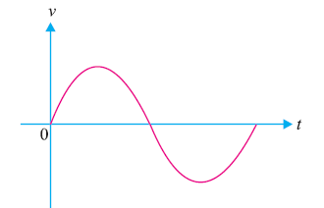
Analog and Digital Signals
(i) Analog signal. A continuously varying signal (voltage or current) is called an analog signal.
For example, an alternating voltage varying sinusoidally is an analog signal [See Fig.1]. If such an analog signal is applied to the input of a transistor amplifier, the output voltage will also vary sinusoidally. This is the analog operation i.e., the output voltage can have an infinite number of values. Due to many-valued output, the analog operation is less reliable.

Slide 2
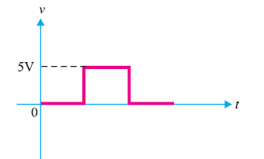
ii) Digital signal. A signal (voltage or current) that can have only two discrete values is called a digital signal. For example, a square wave is a digital signal [See Fig.2]. It is because this signal has only two values viz, +5 V and 0 V and no other value. These values are labeled as High and Low. The High voltage is + 5 V and the Low voltage is 0 V. If proper digital signal is applied to the input of a transistor, the transistor can be driven between cut off and saturation. In other words, the transistor will have two-state operations i.e., output is either low or high. Since digital operation has only two states (i.e., ON or OFF), it is far more reliable than many-valued analog operation. It is because with two states operation, all the signals are easily recognized as either low or high.

Slide 3
Digital Circuit
An electronic circuit that handles only a digital signal is called a digital circuit. The output voltage of a digital circuit is either low or high and no other value. In other words, digital operation is a two-state operation. These states are expressed as (High or Low) or (ON or
OFF) or (1 or 0). Therefore, a digital circuit is one that expresses the values in digits 1’s or 0’s.
Hence the name digital. The numbering concept that uses only the two digits 1 and 0 is the binary
numbering system. Therefore, the first step would be to discuss this number system.

Slide 4
Binary Number System
A number system is a code that uses symbols to count the number of items.
The most common and familiar number system is the decimal number system.
The decimal number system uses the symbols
0, 1, 2, 3, 4, 5, 6, 7, 8 and 9. Thus, the decimal system uses 10 digits for counting the items.
A binary system uses only two digits (0 and 1) for counting the items. The reader may wonder how to count the items in a binary system.

Slide 5
Counting in Decimal and Binary systems
Figure.3 shows the counting of stones in decimal as well as binary system. As you will see, the counting in the binary number system is performed much the same way as in the decimal number system.

Slide 6
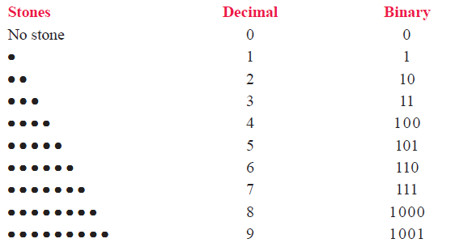
Counting in Decimal and Binary systems

Slide 7
i) Let us first see how items are counted in decimal system. In this system, the count starts as 0, 1, ...., 9. After 9, we are to write the next number. To do so, we use the second digit of the decimal system (i.e., 1) followed by the first digit (i.e., 0). So after 9, the next number is 10.
In order to represent a number next to 99, we use three decimal digits (100).
That is to say second digit of the decimal system (i.e., 1) followed by two first digits (i.e, two zeros).

Slide 8
binary system
ii) Let us now turn to binary system. Note that 0 and 1 count in the binary system is the same as in the decimal counting. To represent 2 stones, we use the second binary digit (i.e., 1) followed by the first (i.e., 0).
This gives binary number 10 (read as one-zero and not ten) as an equivalent of 2 in the decimal system.
After this, the two binary digits are exhausted. We shall use three digits to represent the next binary number. Thus, to represent 4 (four), we use the second binary digit followed by two first binary digits. This gives the binary *100 (read as one-zero-zero) as equivalent to 4 in the decimal system.

Slide 9
Notes
(i) Each binary digit (0 or 1) is referred to as a bit. A string of four bits is called as a nibble and eight bits make a byte. Thus, 1001 is a nibble and 10010110 is a binary byte.
(ii) The binary number system is the most useful in digital circuits because there are only two digits (0 and 1).

Slide 10
Place Value
Consider the decimal number 642. This can be expressed as :
642 = 600 + 40 + 2
Note that in a multi digit decimal number (i.e., 642 in the present case), each position has a value that is 10 times the value of the next position to its immediate right. In other words, every position can be expressed as :
642 = 6 × 102 + 4 × 101 + 2 × 100
Thus, we find that values of various positions in a decimal number system are powers of 10

Slide 11
LSD & MSD
For the decimals, the digit to the extreme right is referred to as the least significant digit (LSD)
because its positional value or weight is the lowest. For the decimal number 642, 2 is the LSD.
The left-most digit in the decimal number is the most significant digit (MSD) because its positional value or weight is the highest.

Slide 12
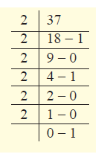
Binary number system.

Slide 13
Binary-Coded Decimal Code (BCD Code)
In a BCD code, each decimal number is represented by a 4-bit binary number. For example, to convert decimal number (489)10 to BCD, the procedure is as under :
4 8 9
0100 1000 1001

Slide 14
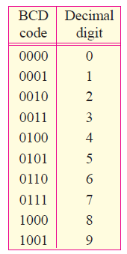

Slide 15
Logic Gates

Slide 16
Encoders and Decoders
i) Convert the information from decimal to digital (binary) form.
(ii) Process the digital information.
(iii) Convert the digital output back to decimal form.
The circuit that converts decimal form to digital (binary) form is called encoder and the circuit that converts digital form to decimal form is called decoder.

Slide 17
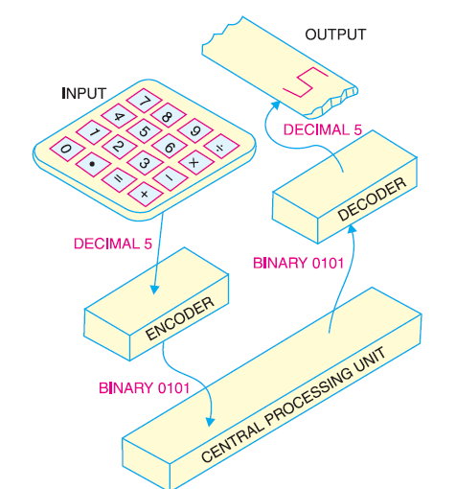
Encoders and Decoders

Slide 18
Advantages and Disadvantages of Digital Electronics
The world of electronics can be classified as either digital or analog circuits. An increasing majority of applications in electronics use digital techniques to perform operations that were once performed using analog methods. It is worthwhile to give advantages and disadvantages of digital electronics.
Advantages. The chief reasons for the shift to digital technology are :
(i) Digital systems are generally easier to design. It is because the circuits that are used are switching circuits where exact values of voltages or currents are not important, only the range (HIGH or LOW) in which they fall is important.
(ii) Digital circuits provide greater accuracy and precision. It is because digital circuits can handle as many digits of precision as you need simply by adding more switching circuits. In analog systems, precision is usually limited to three or four digits because the values of voltage and current are directly dependent on the circuit components.

Slide 19
Advantages
(iii) Digital circuits are less affected by noise. Suprious fluctuations in voltage (noise) are not as critical in digital systems as in analog systems. It is because in a digital circuit, the exact value of a voltage is not important as long as the noise is not large enough to prevent us from distinguishing a HIGH from a LOW.
(iv) More digital circuitry can be fabricated on IC chips. Analog system uses such devices (high-value capacitors, inductors, transformers) that cannot be economically integrated. For this reason, analog systems cannot achieve the same degree of integration as digital circuits.
(v) Information storage is easy with digital circuits.

Slide 20
Disadvantages
(i) The real world is mainly analog. However, the digital circuits can handle only digital signals. This necessitates encoders and decoders which increase the cost of the equipment.
(ii) There are situations where using only analog techniques is simpler and more economical. For example, the process of signal amplification is most easily accomplished using analog circuitry. However, advantages of digital techniques outweigh the disadvantages. For this reason, we are fast switching to digital techniques.

Slide 21
The Shift Register
The Shift Register is another type of sequential logic circuit that can be used for the storage or the transfer of data in the form of binary numbers. This sequential device loads the data present on its inputs and then moves or “shifts” it to its output once every clock cycle, hence the name “shift register”

Slide 22
The Shift Register
A shift register basically consists of several single bit “D-Type Data Latches”, one for each data bit, either a logic “0” or a “1”, connected together in a serial type daisy-chain arrangement so that the output from one data latch becomes the input of the next latch and so on.

Slide 23
Shift Registers are used for data storage or for the movement of data and are therefore commonly used inside calculators or computers to store data such as two binary numbers before they are added together, or to convert the data from either a serial to parallel or parallel to serial format

Slide 24
Types of shift register
• Serial-in to Parallel-out (SIPO) - the register is loaded with serial data, one bit at a time, with the stored data being available at the output in parallel form.
• Serial-in to Serial-out (SISO) - the data is shifted serially “IN” and “OUT” of the register, one bit at a time in either a left or right direction under clock control.
• Parallel-in to Serial-out (PISO) - the parallel data is loaded into the register simultaneously and is shifted out of the register serially one bit at a time under clock control.
• Parallel-in to Parallel-out (PIPO) - the parallel data is loaded simultaneously into the register, and transferred together to their respective outputs by the same clock pulse.

Slide 25
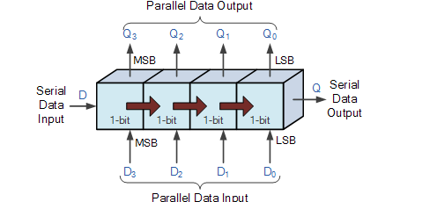
Types of shift register

Slide 26
Integrated circuit (ICs)
While there are many ICs containing only digital circuits and many that contain only linear circuits, there are a number of units that contain both linear and digital circuits.
Among the linear/digital ICs are
comparator circuits,
digital/analog converters,
interface circuits,
timer circuits,
voltage controlled oscillator (VCO) circuits,
and phase locked loops (PLLs).

Slide 27
Electronic Devices and circuits theory

Slide 28
Circuits that convert digital signals into an analog or linear voltage,
and those that convert a linear voltage into a digital value, are popular in aerospace equipment,
Automotive equipment, and compact disk (CD) players, among many others

Slide 29
Timer ICs provide linear and digital circuits to use in various timing operations,
as in a car alarm, a home timer to turn lights on or off, and a circuit in electromechanical
equipment to provide proper timing to match the intended unit operation.
The 555 timer has long been a popular IC unit

Slide 30
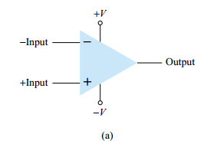
COMPARATOR UNIT OPERATION
A comparator circuit accepts input of linear voltages and provides a digital output that indicates when one input is less than or greater than the second.
A basic comparator circuit can be represented as in Fig. 17.1a. The output is a digital signal that stays at a high voltage level when the noninverting (+) input is greater than the voltage at the inverting (-) input and switches to a lower voltage level when the noninverting input voltage goes below the inverting input voltage
Figure 17.1 Comparator unit:
(a) basic unit;

Slide 31
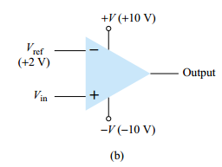
Figure 17.1b shows a typical connection with one input . As long as Vin is less than the reference voltage level of 2 V, the output remains at a low voltage level (near 10 V).
When the input rises just above 2 V, the output quickly switches to a high-voltage level (near 10 V). Thus the high output indicates that the input signal is greater than 2 V.
Figure 17.1 Comparator unit:
(b) typical application.

Slide 32
we can examine the operation of a comparator using a 741 op-amp, as shown in Fig. 17.2.
With reference input (at pin 2) set to 0 V, a sinusoidal signal applied to the noninverting input (pin 3) will cause the output to switch between its two output states, as shown in Fig. 17.2b

Slide 33
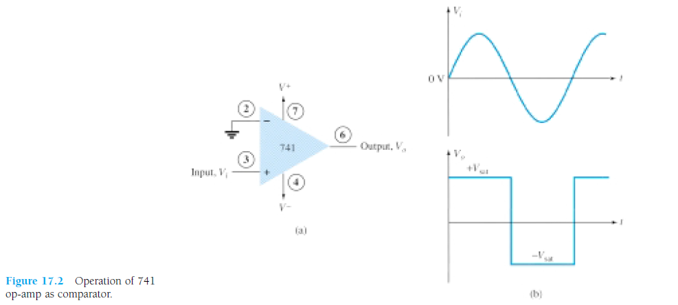

Slide 34
